Slide 1


Vending Machine
Team ByteBurst

Slide 2




MEET OUR TEAM
RAKSHITH
RICKSON DSOUZA
SAHAJ SHETTY
SANJAY K R
Team Lead
Member 1
Member 2
Member 3

Slide 3
Table of Contents
Introduction​
Objectives
​Block Diagram/Flowchart
Components used/Software used
Benefits to the Society
Timeline​​

Slide 4
Introduction
What is the Issue: Hard to get stationary items in a busy college shop.
Who is it for: Students needing quick supplies
What are the previous available solutions: Crowded shop
What is your idea: Smart vending machine – easy, quick, no chaos

Slide 5
Objectives
To develop a fully functioning vending machine
To avoid crowding in the xerox center to buy stationery items
Draw attention of students and staff by this new initiative in the campus
Best service in less time

Slide 6
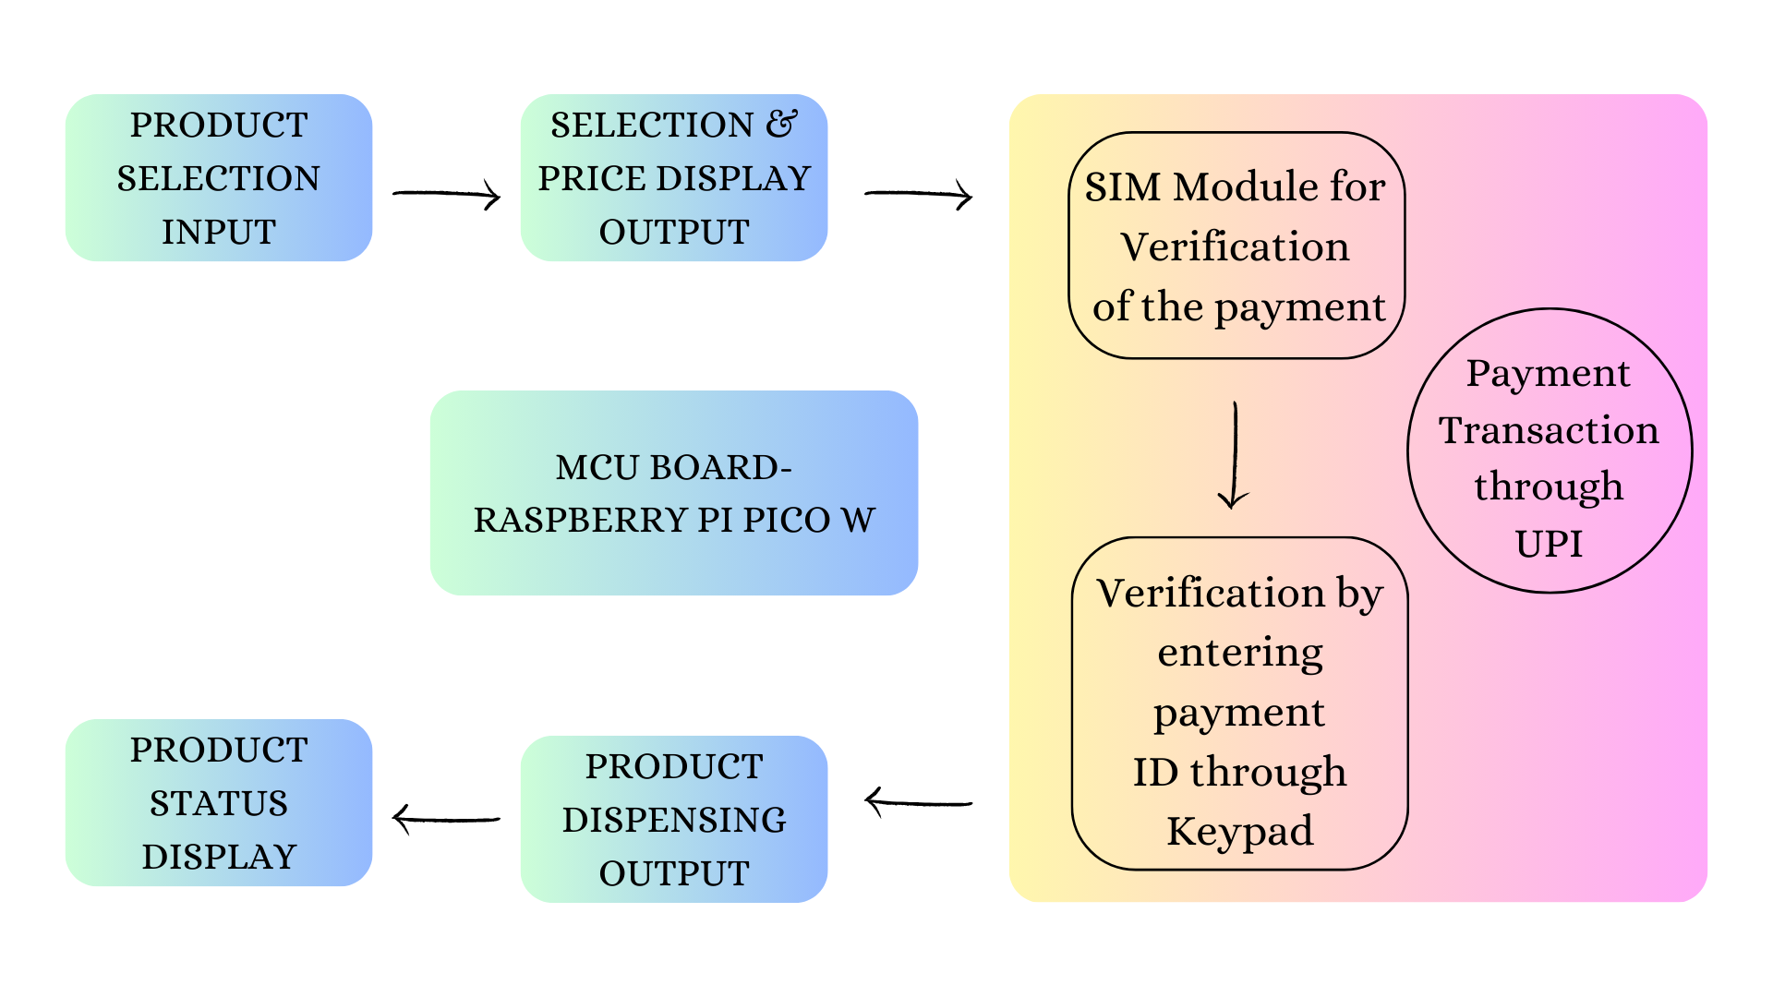
Block Diagram

Slide 7
Components used
Hardware:
Components | Quantity | Cost
Raspberry PI PICO W | X1 | ₹600
SIM800L V2.0 5V Wireless GSM GPRS MODULE Quad-Band with Antenna | X1 | ₹460
Waveshare 2.42inch OLED Display | X1 | ₹1500
4×3 Matrix 12 keys Membrane Switch Keypad | X1 | ₹56
Momentary Round Cap Push Button Switch | X8 | ₹130
360° Servo Motor MG996R | X6 | ₹2000
PCB Design (for power supply) |  | ₹3000
Metal Structure
3D Filament (for product dispensing compartment design)
Total Cost |  | ~₹7746

Slide 8
Benefits to the Society
Promoting cashless transactions
24X7 availability of the products
Location convenience

Slide 9
Timeline
 | TIMELINE
 | January | February | March | April | May | June
Literature survey
Define Phase
Building Phase
Analyze Phase
Testing Phase
Improve Phase
Report writing

Slide 10
Thank You
Any Questions?

